Slide 1
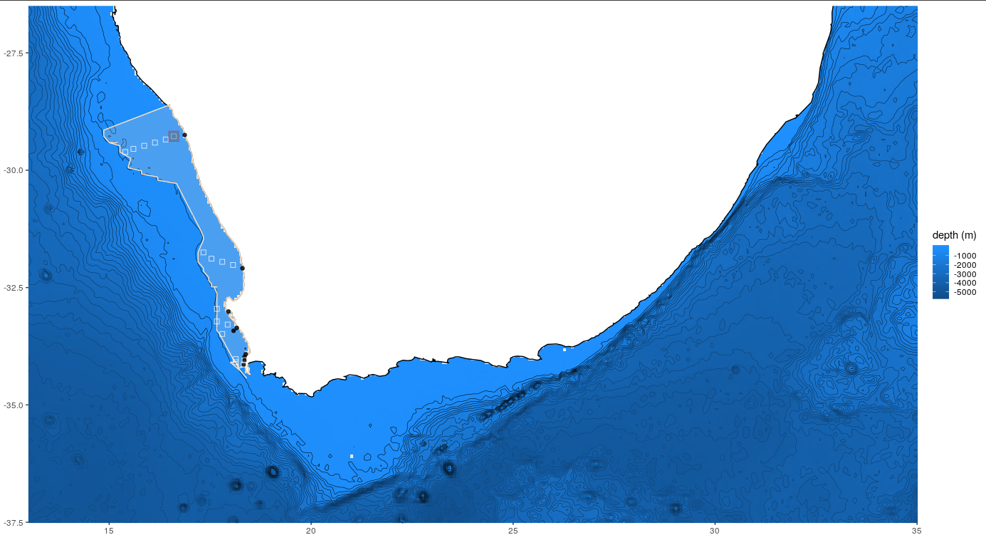
Dynamic properties of the Benguela upwelling system
Notes:
<number>

Slide 2
Wavelets for the different sites along the wc of SA within the upwelling region. Sites are located within the upwelling centre and further away from the upwelling centre. A time series of +- 3 year was used (2012-2015) for these analyses. Four different datasets are used. These include the G1SST, MUR, in-situ SST and OISST
Notes:
<number>

Slide 3
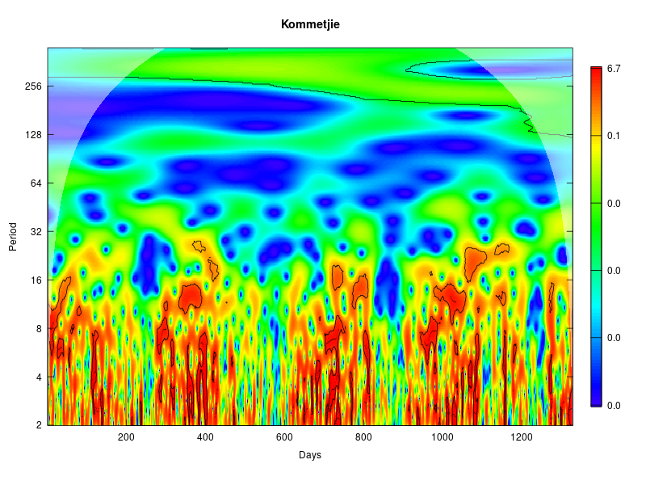
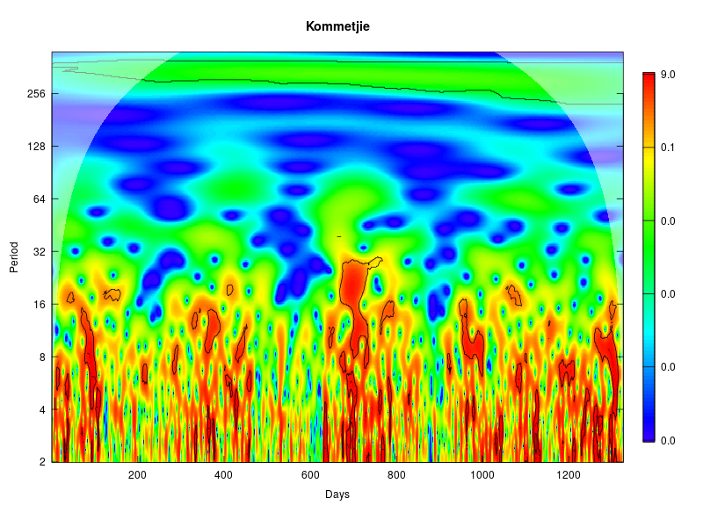
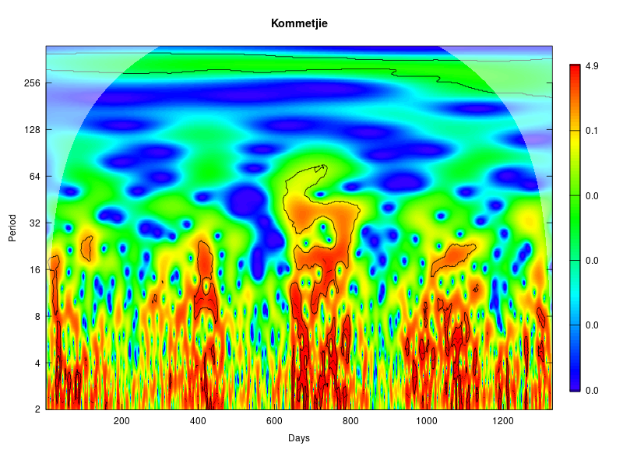
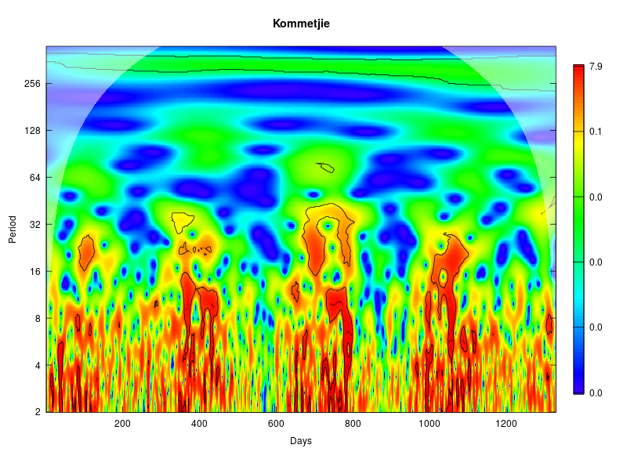
SACTN
MUR
OISST
G1SST
Notes:
<number>

Slide 4
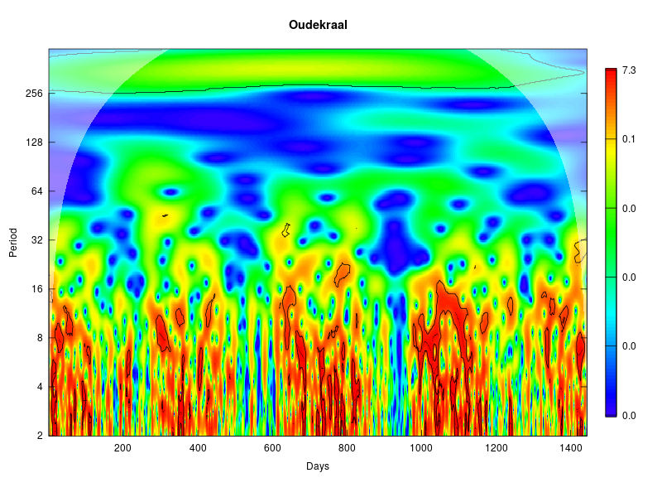
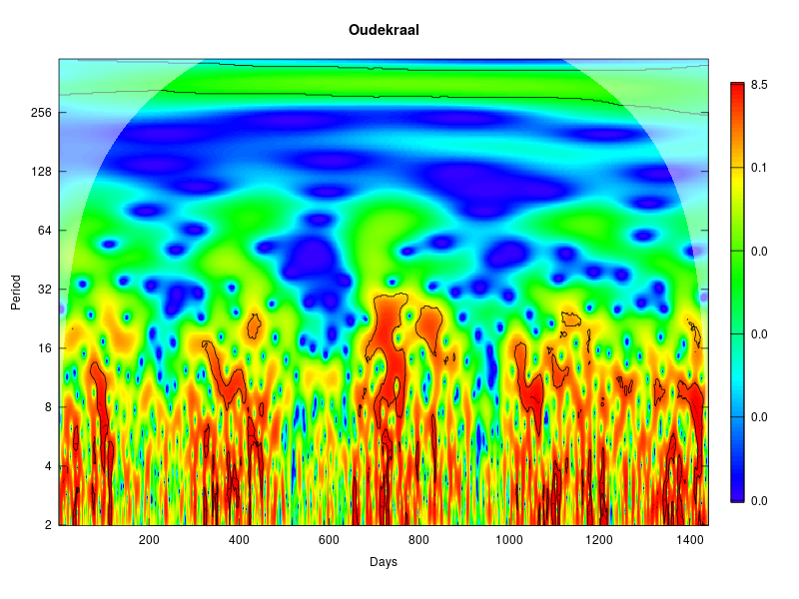
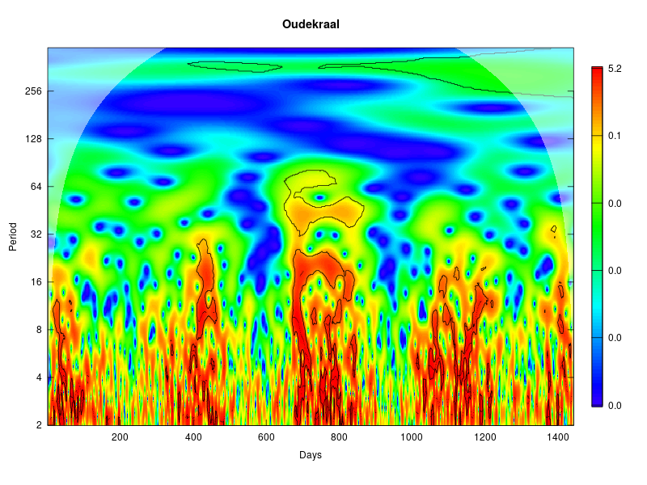
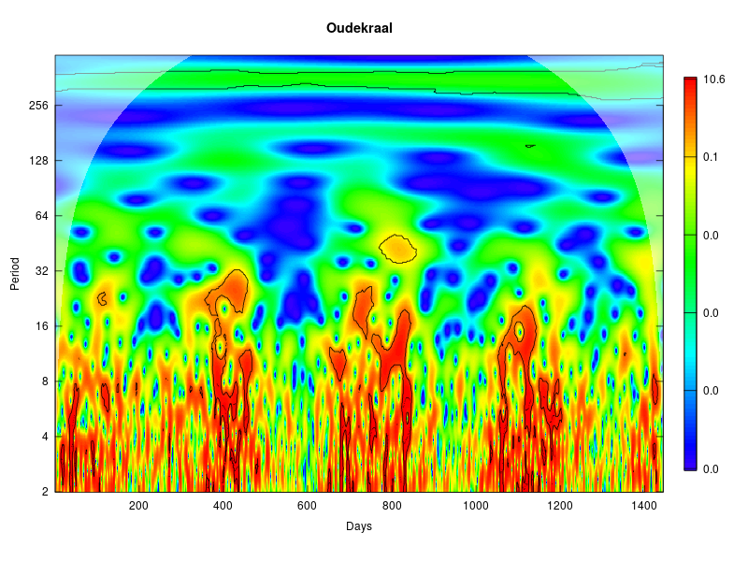
SACTN
MUR
OISST
G1SST
Notes:
<number>

Slide 5
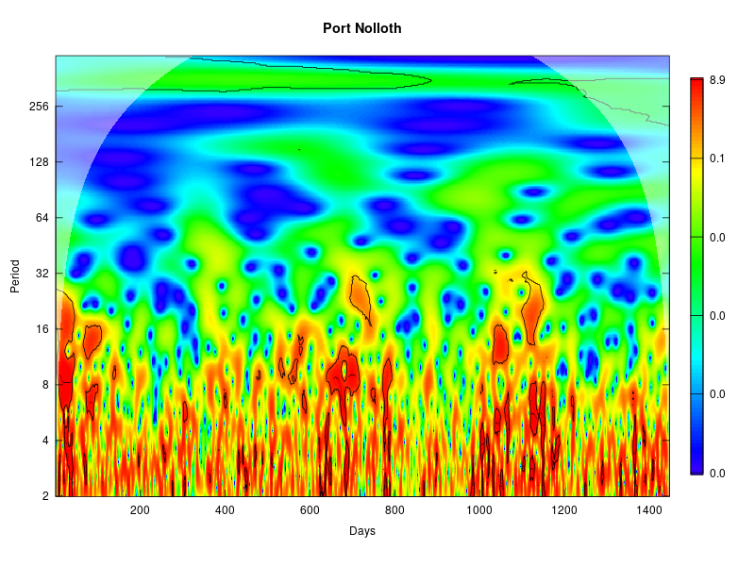
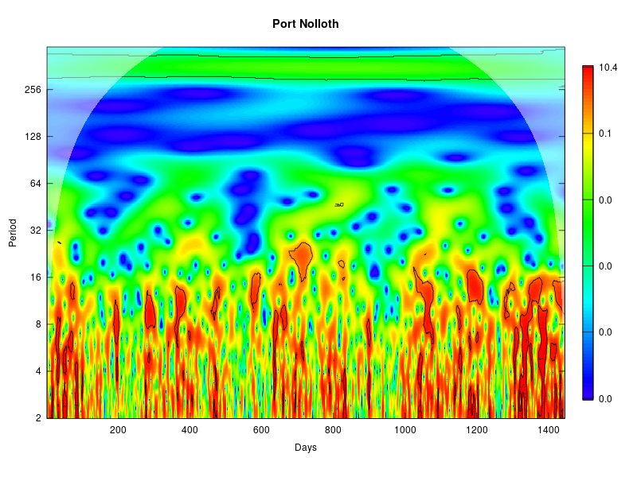
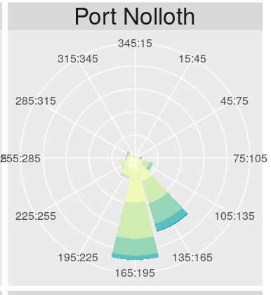
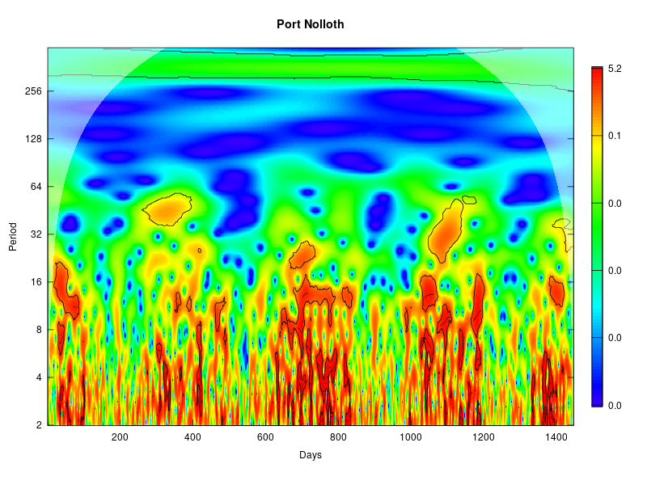
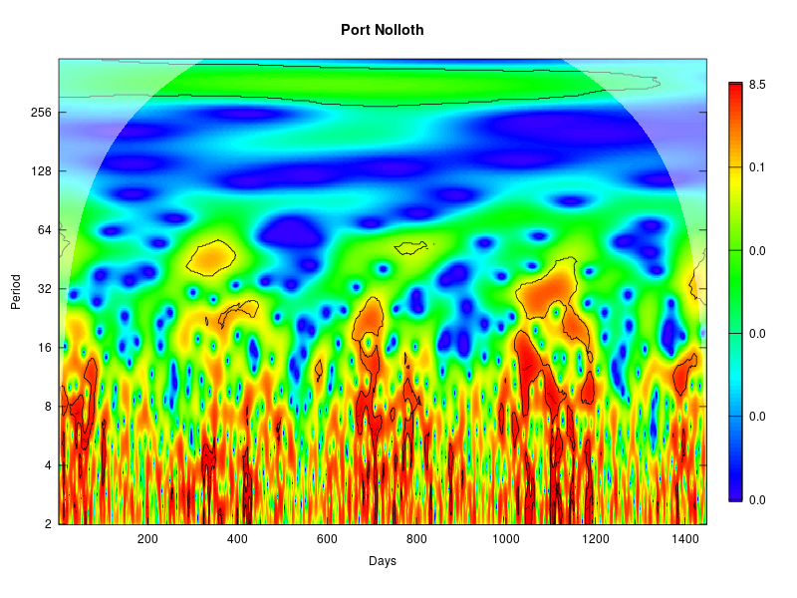
SACTN
MUR
OISST
G1SST
Notes:
<number>

Slide 6
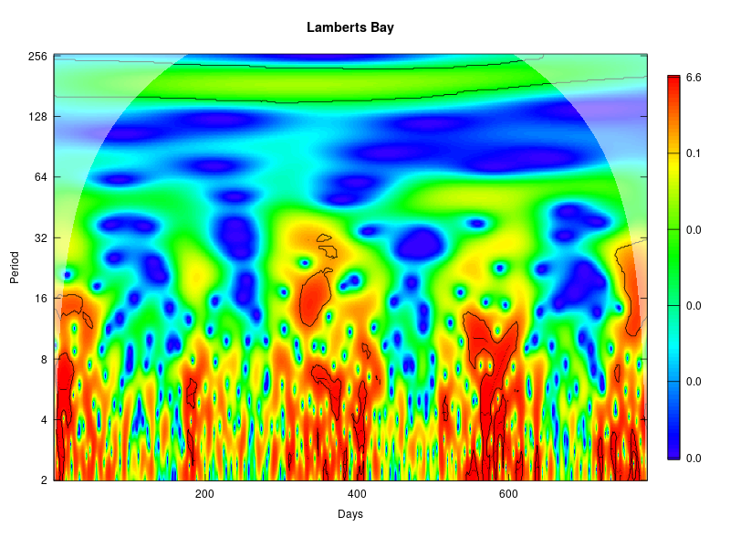
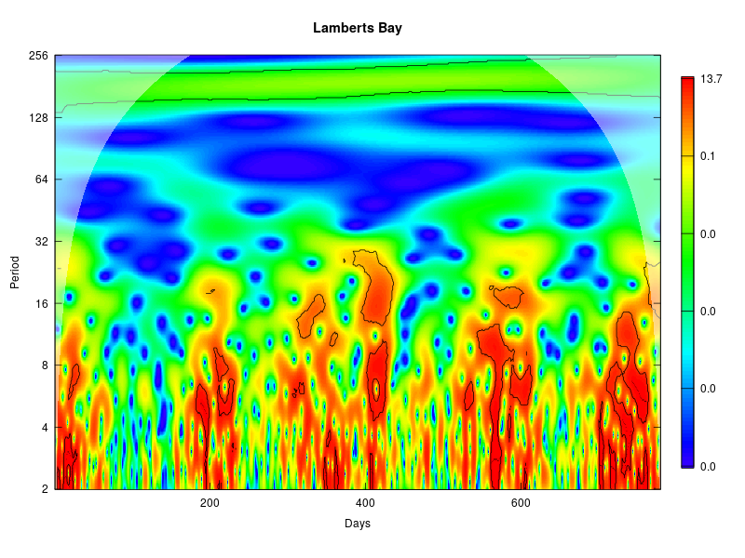
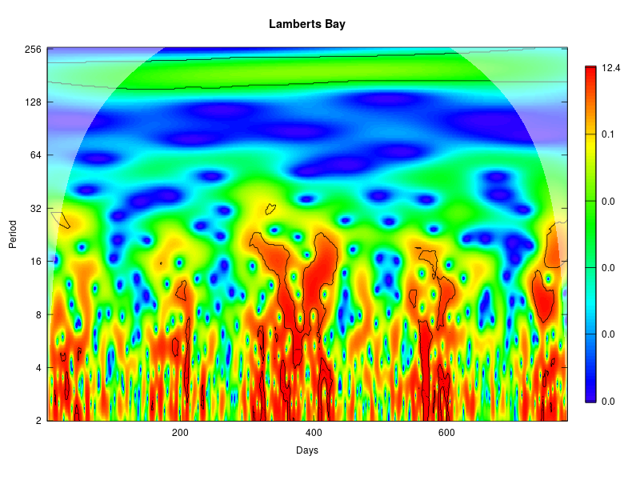
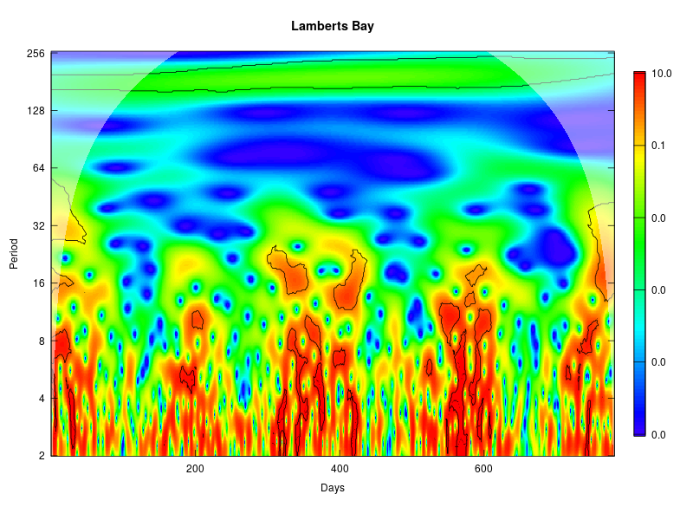
SACTN
MUR
OISST
G1SST
Notes:
<number>

Slide 7
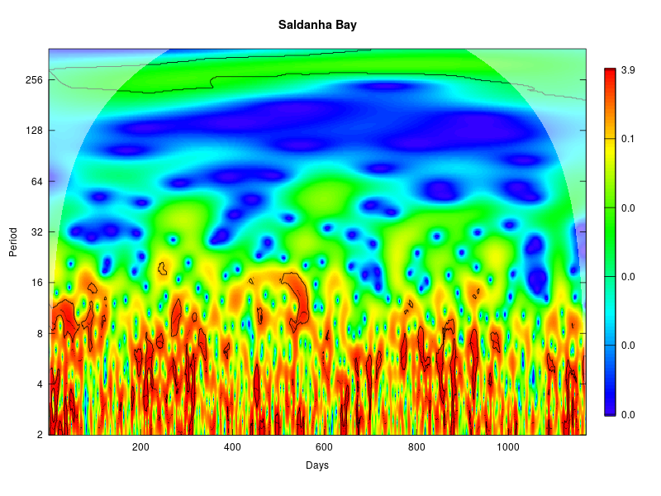
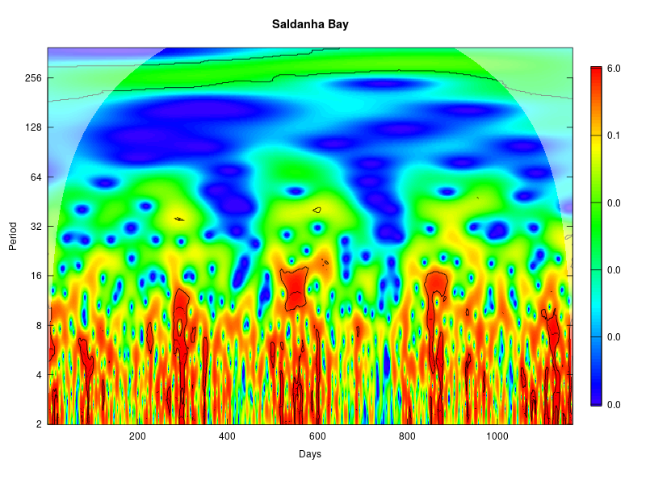
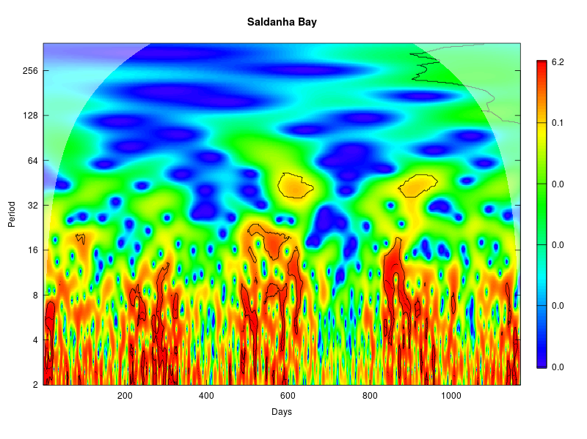
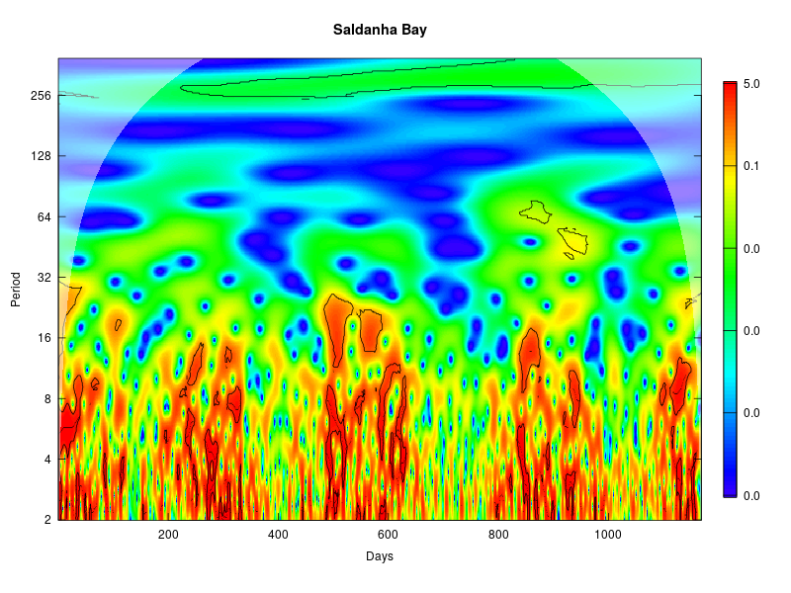
SACTN
MUR
OISST
G1SST
Notes:
<number>

Slide 8
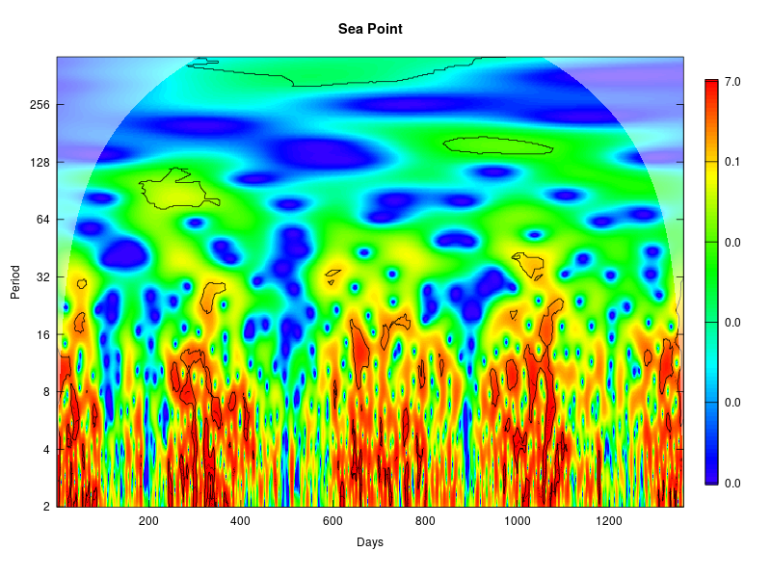
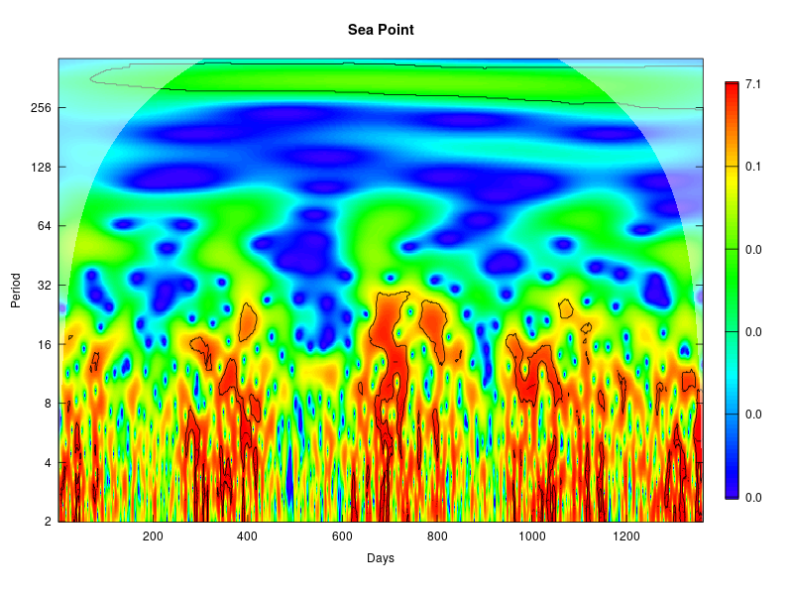
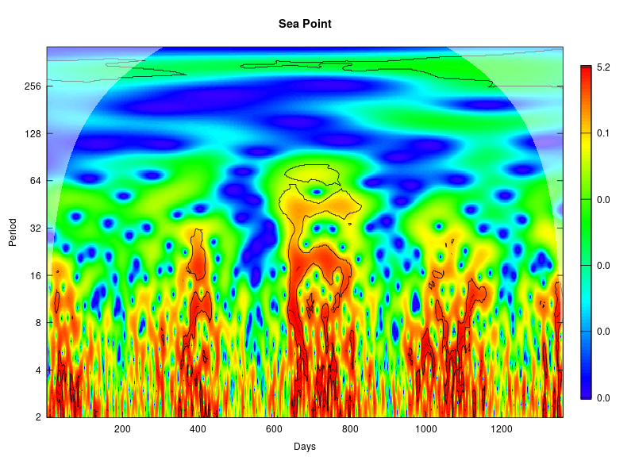
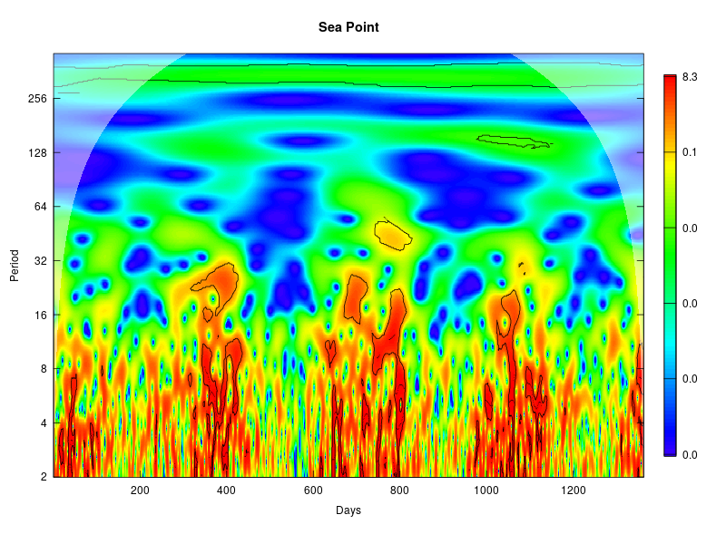
SACTN
MUR
OISST
G1SST
Notes:
<number>

Slide 9
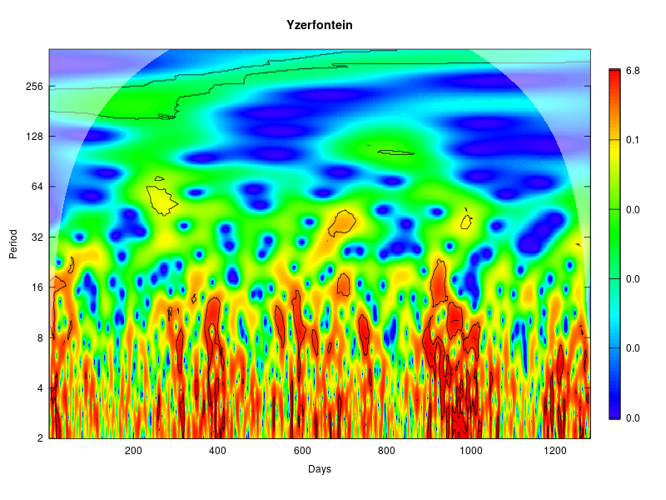
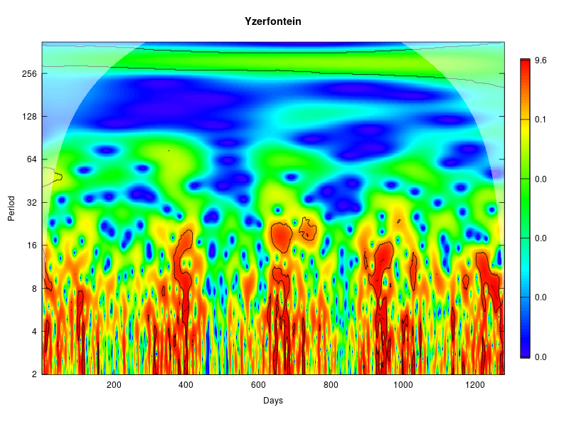
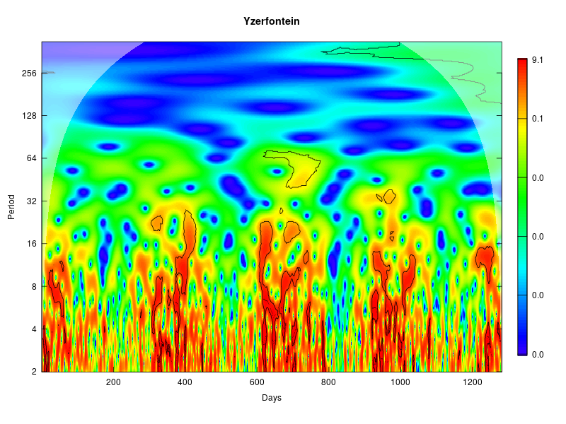
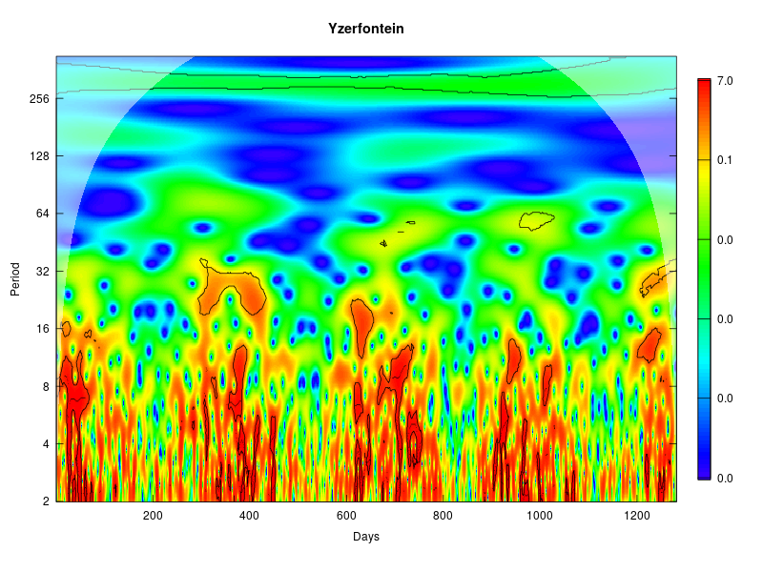
SACTN
MUR
OISST
G1SST
Notes:
<number>

Slide 10
Seasonal wavelets – May be found on Github, see:
MASTERSPROJECT>>figures>>seasonal_wavelets>> “seasonal wavelets for the different SST data types”)
Notes:
<number>

Slide 11
Marine Cold spells and Marine heatwaves: Working with a time series of 30 years but selecting a climatological period from 2002-06-01 – 2015-12-3:
Notes:
<number>

Slide 12
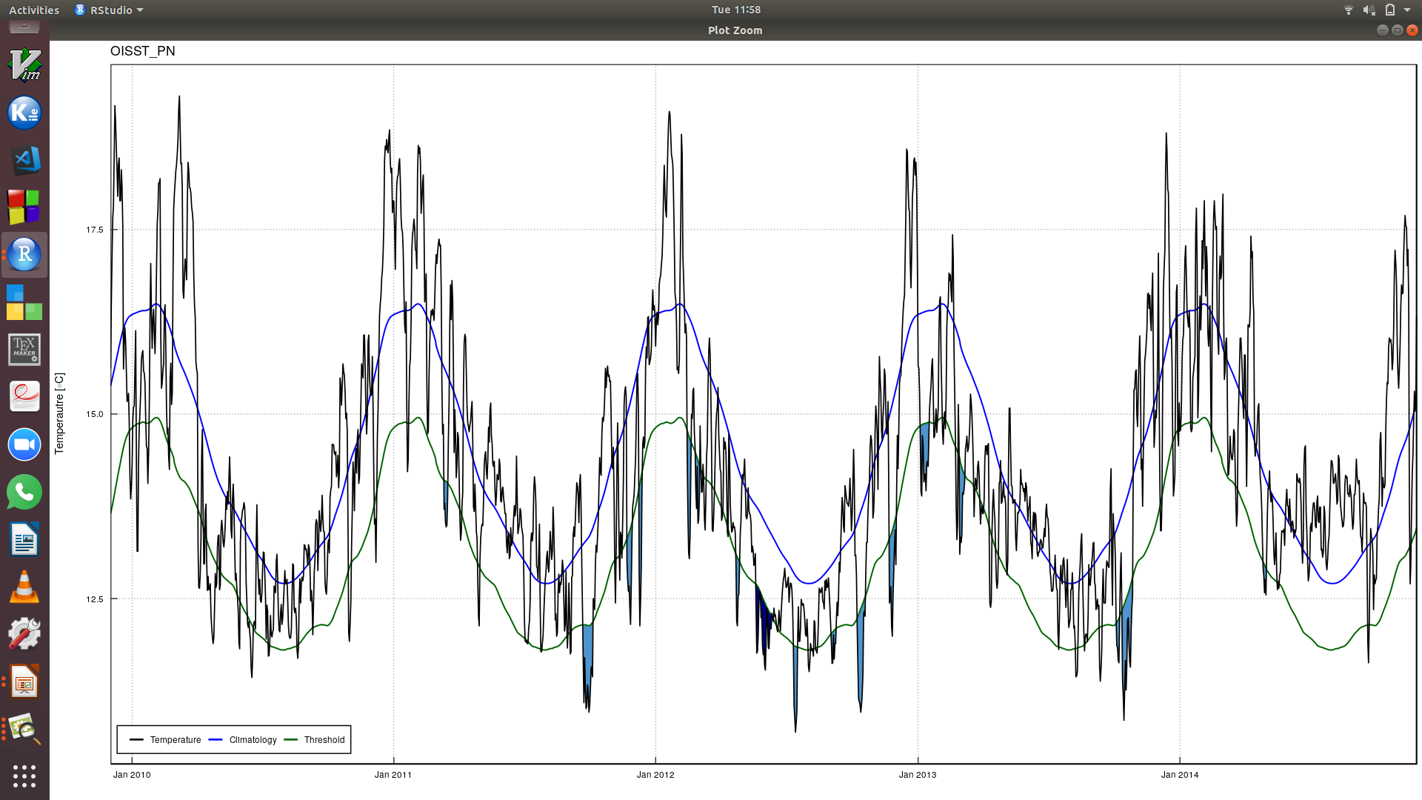
Notes:
<number>

Slide 13
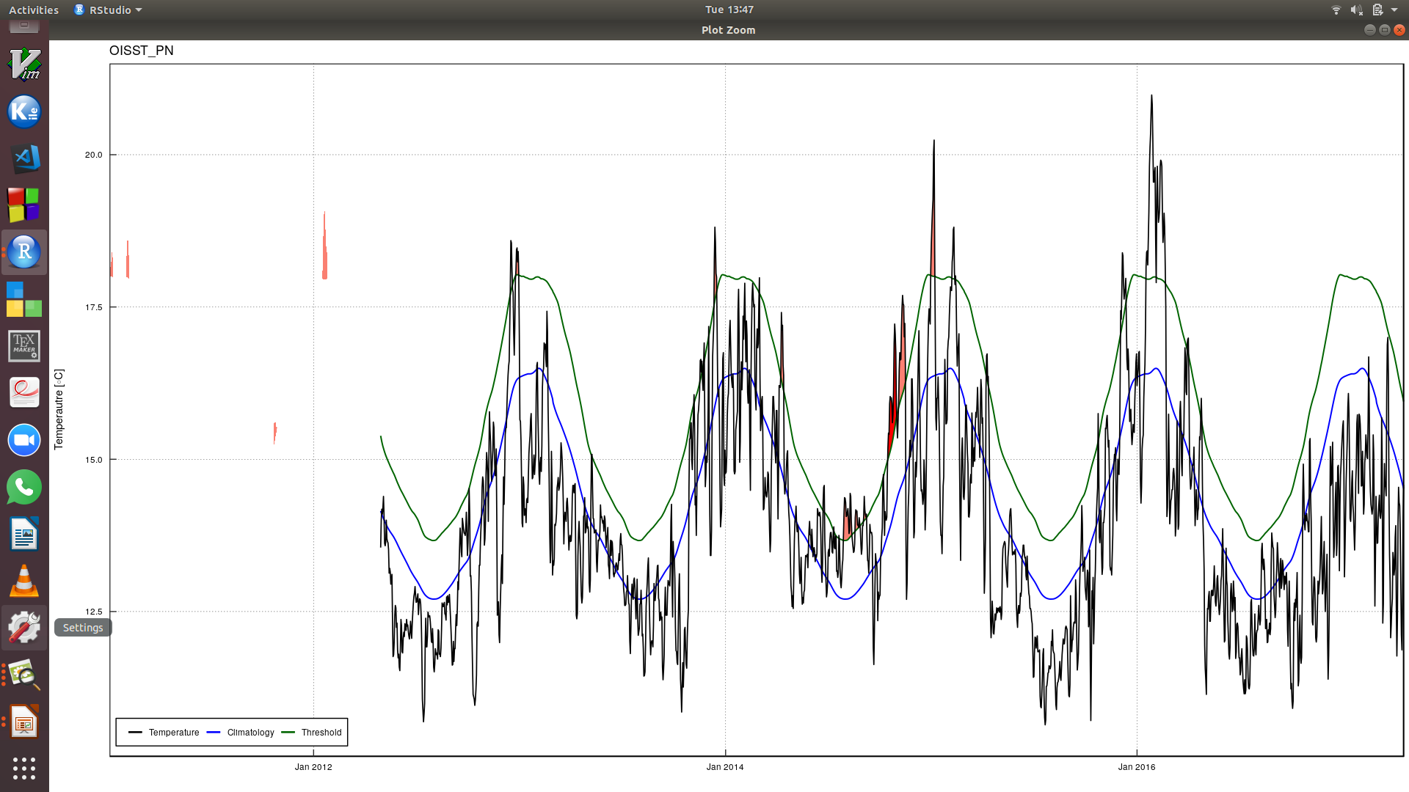
Notes:
<number>

Slide 14
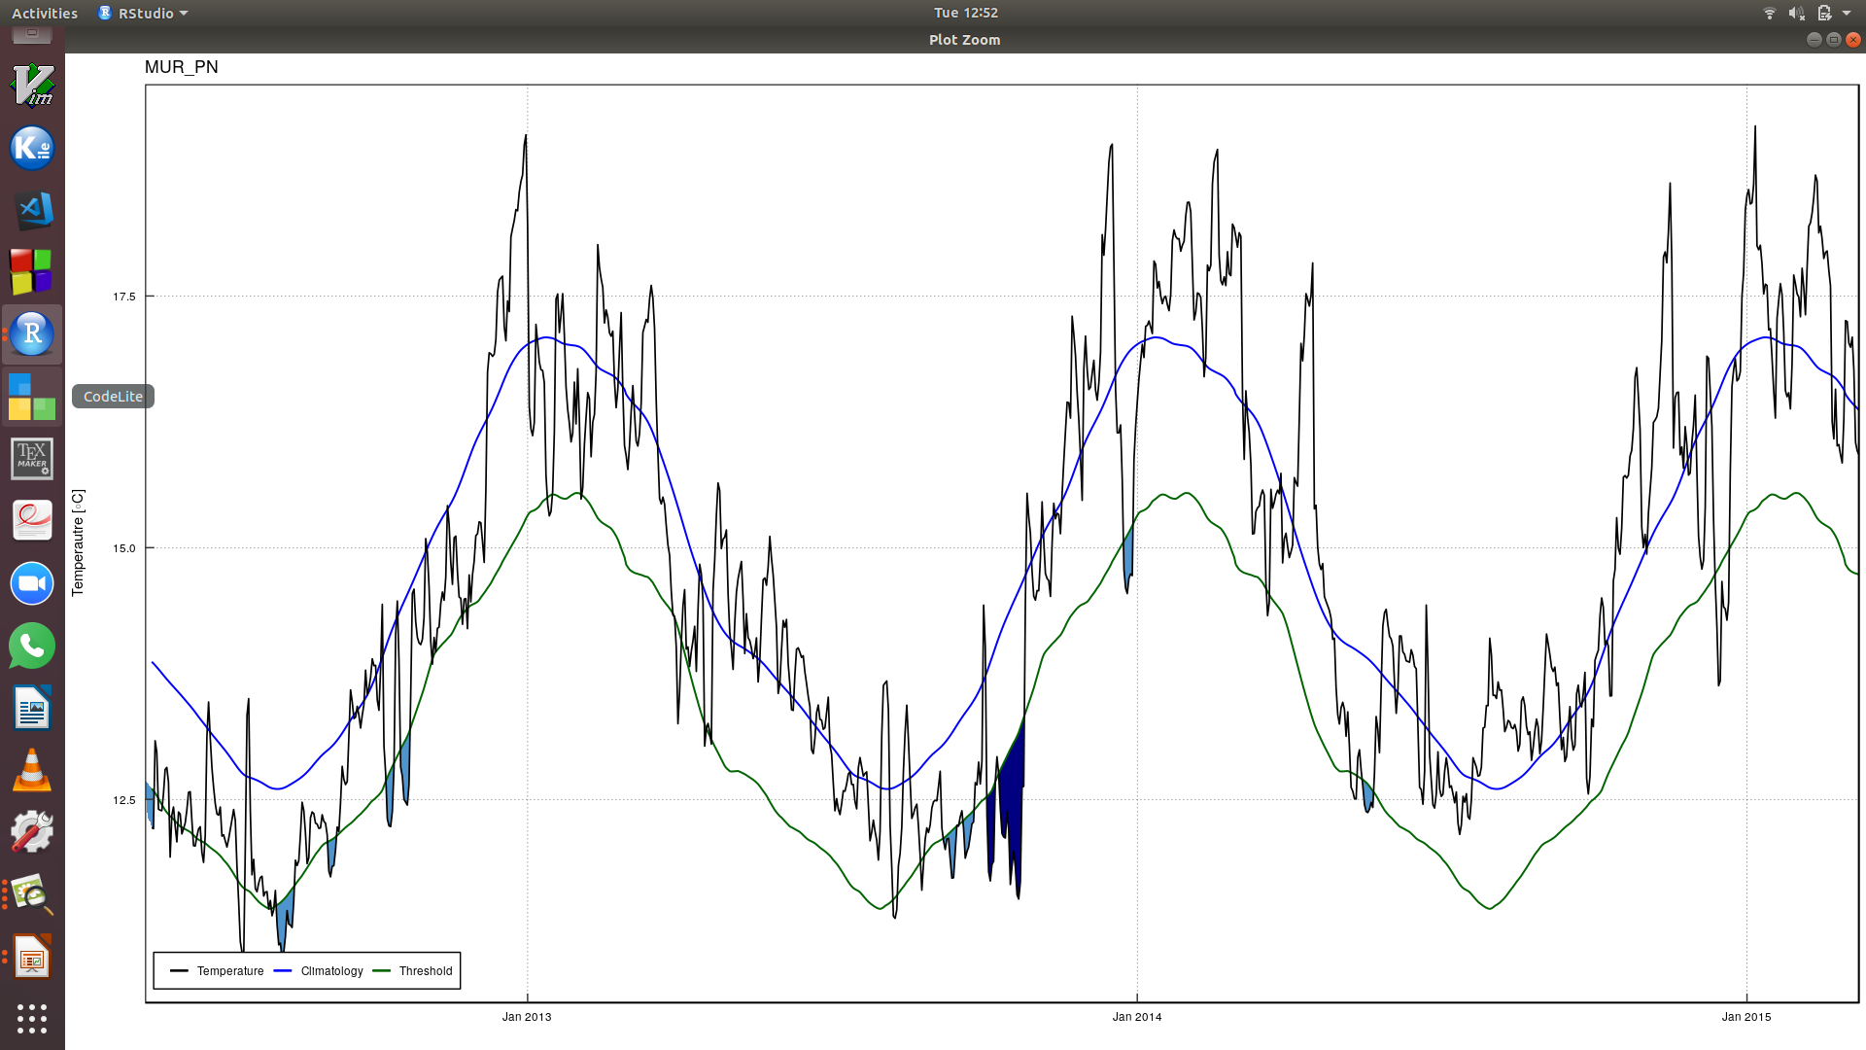
Notes:
<number>

Slide 15
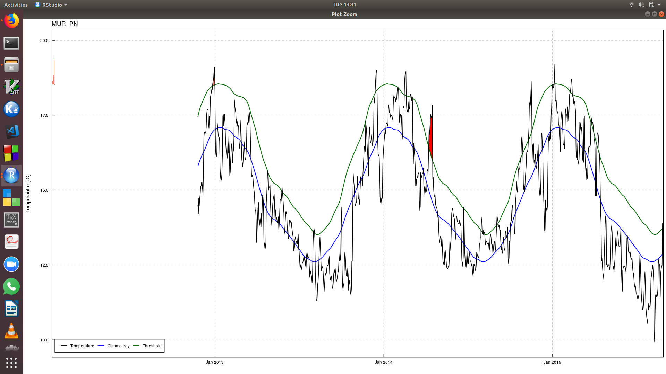
Notes:
<number>

Slide 16
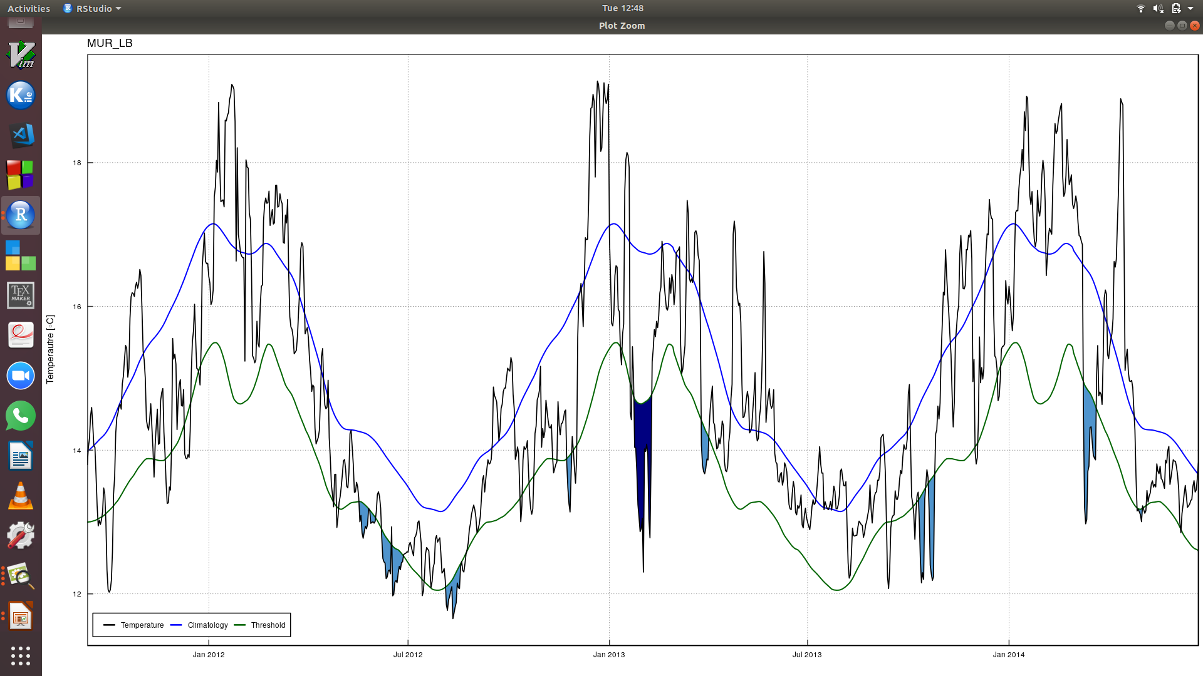
Notes:
<number>

Slide 17
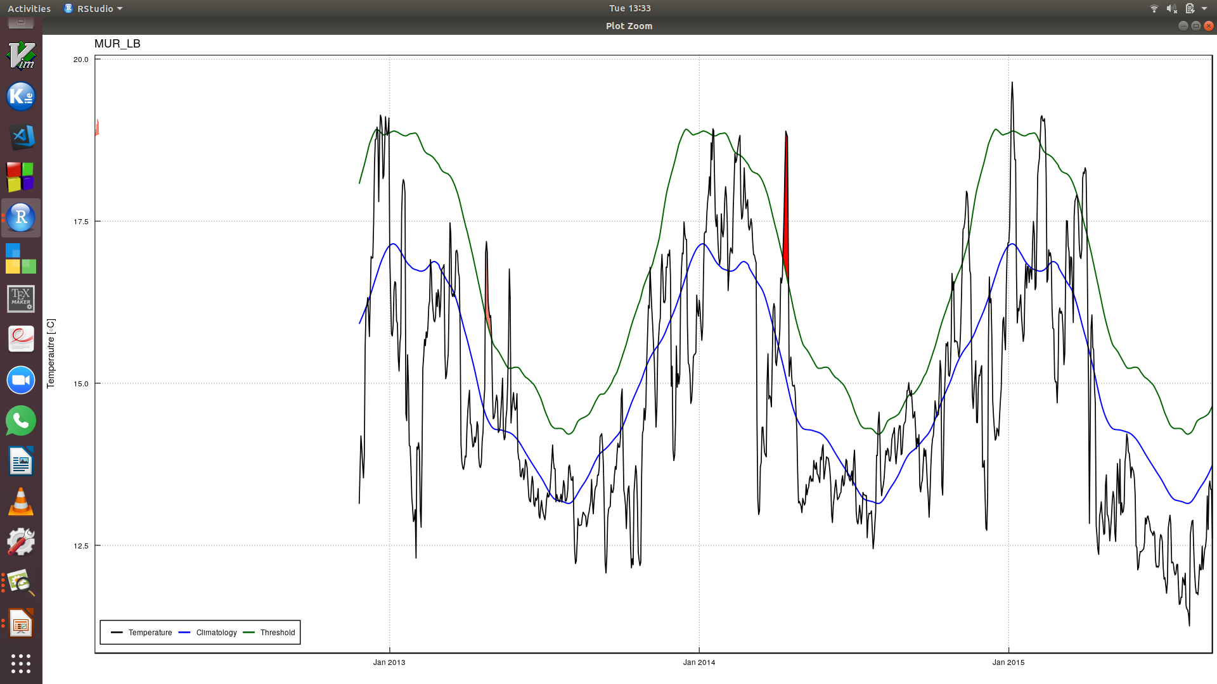
Notes:
<number>

Slide 18
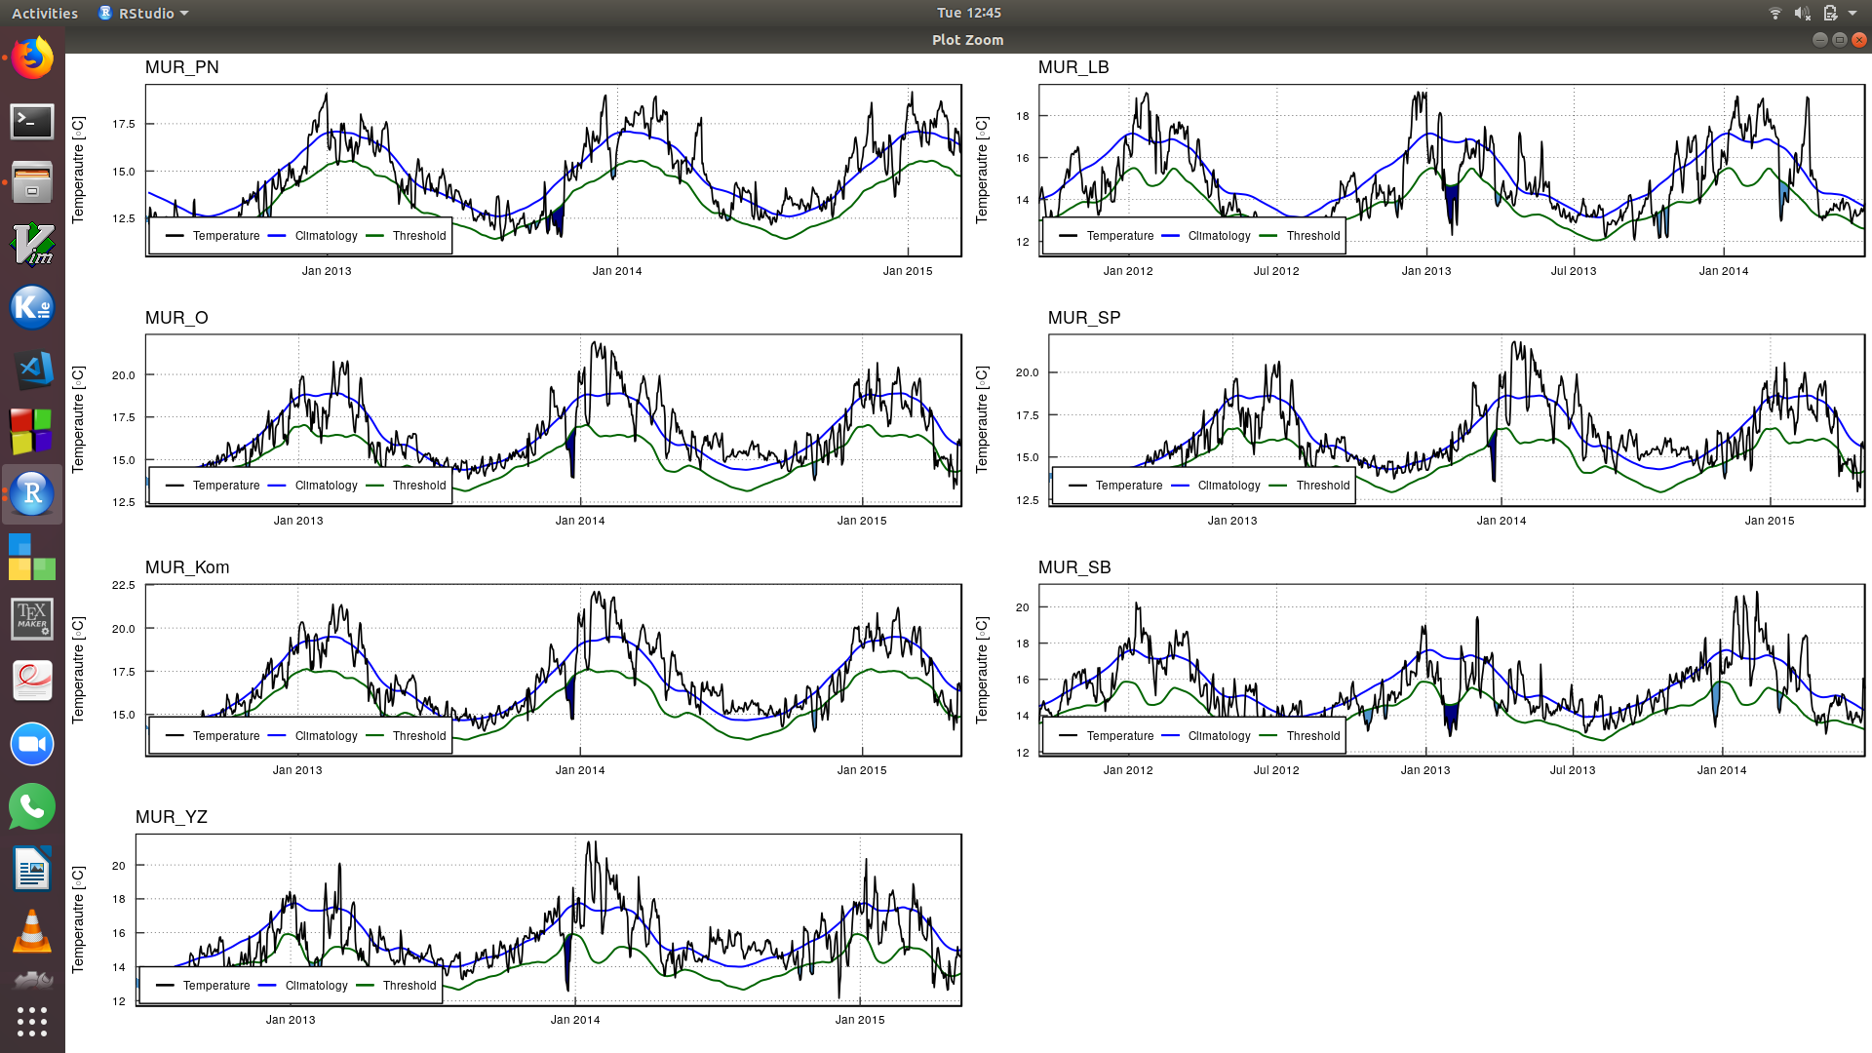
Notes:
<number>

Slide 19
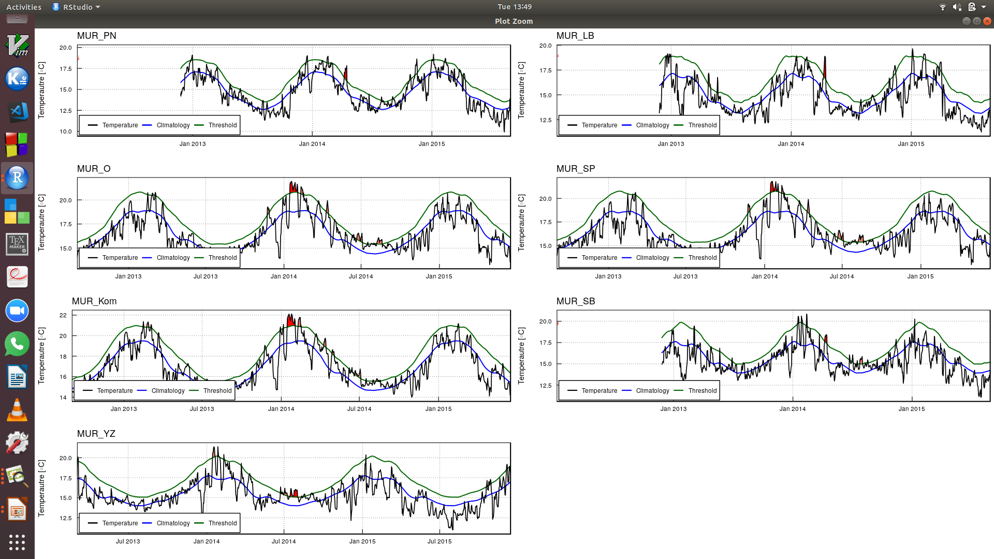
Notes:
<number>

Slide 20
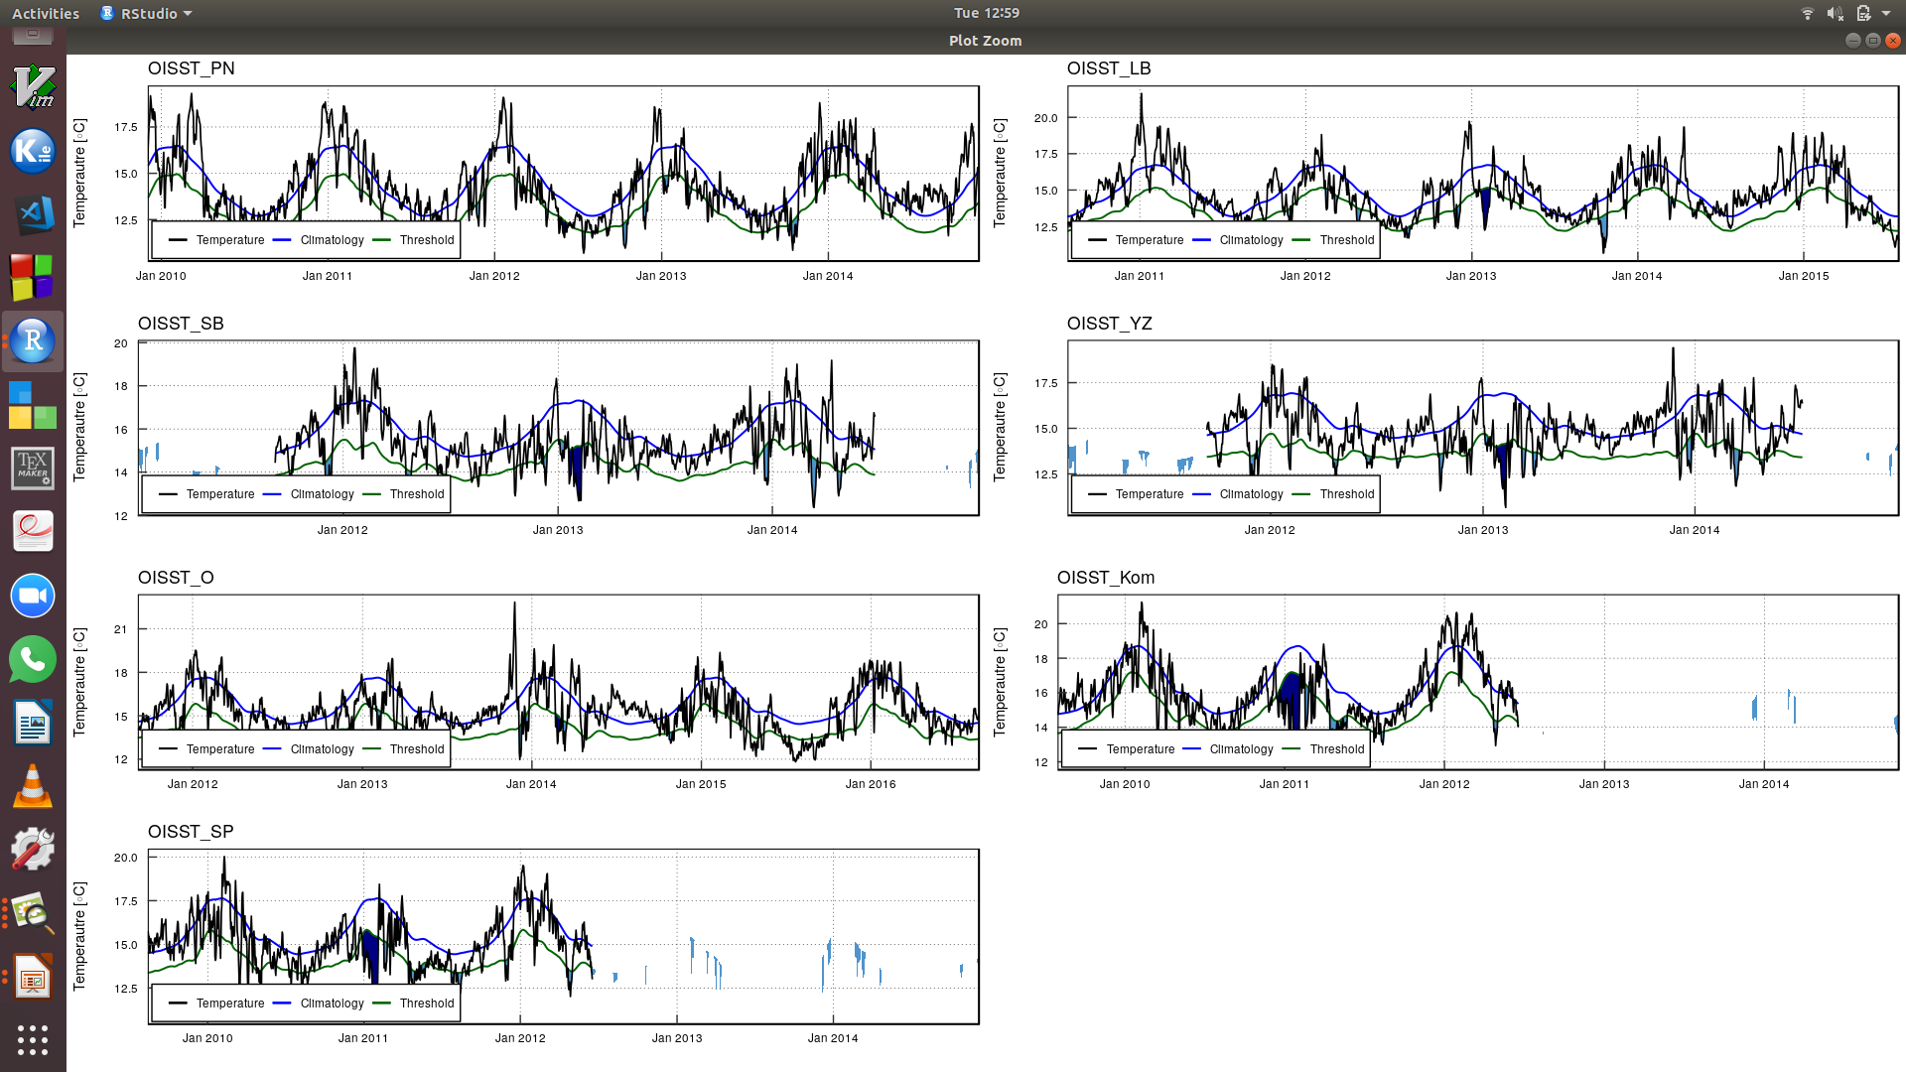
Notes:
<number>

Slide 21
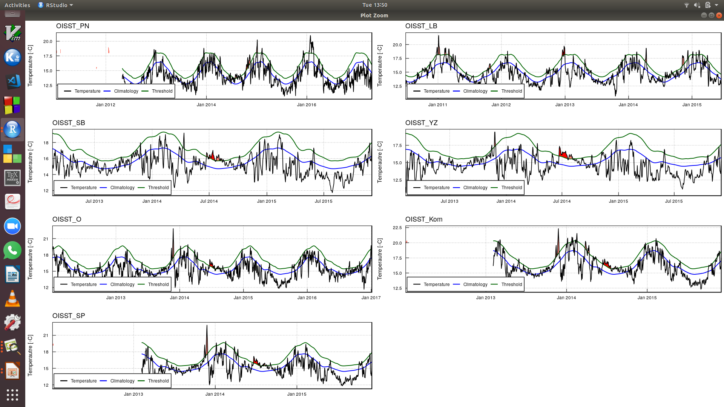
Notes:
<number>

Slide 22
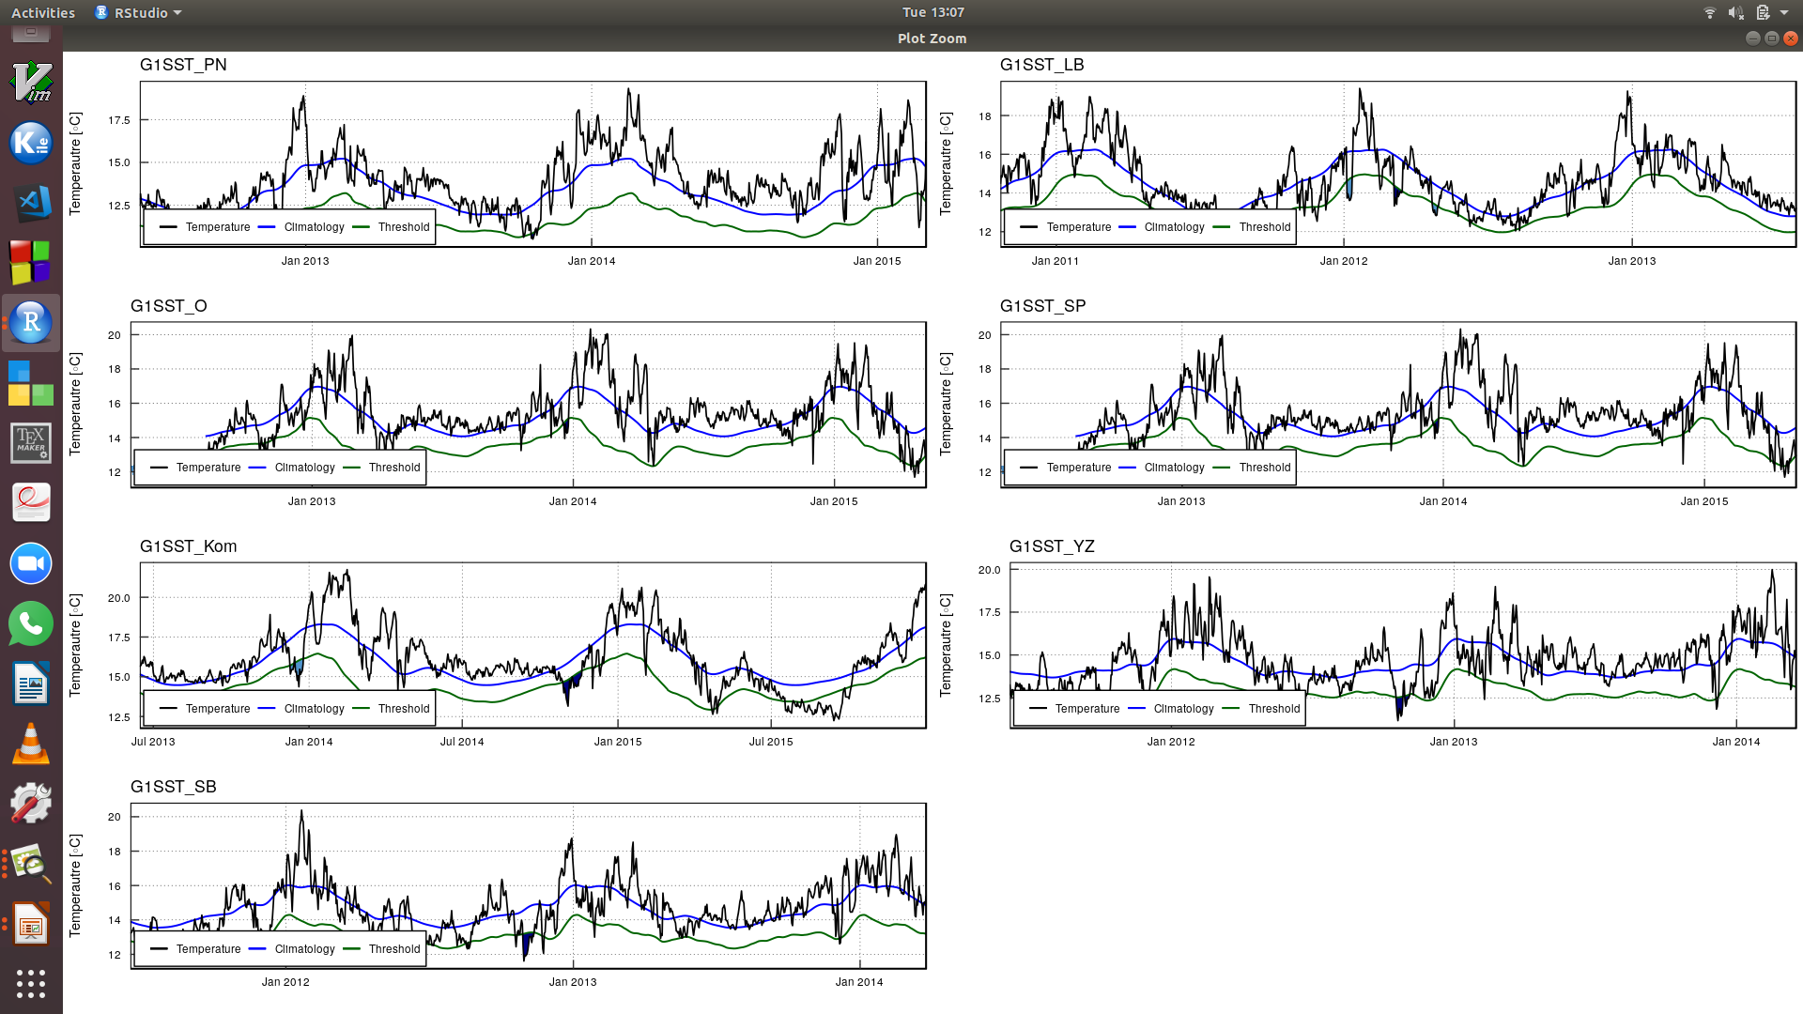
Notes:
<number>

Slide 23
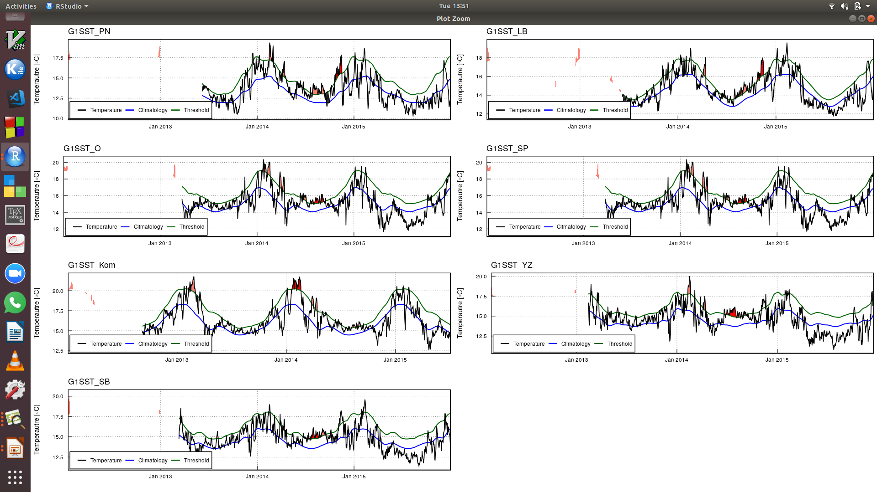
Notes:
<number>

Slide 24
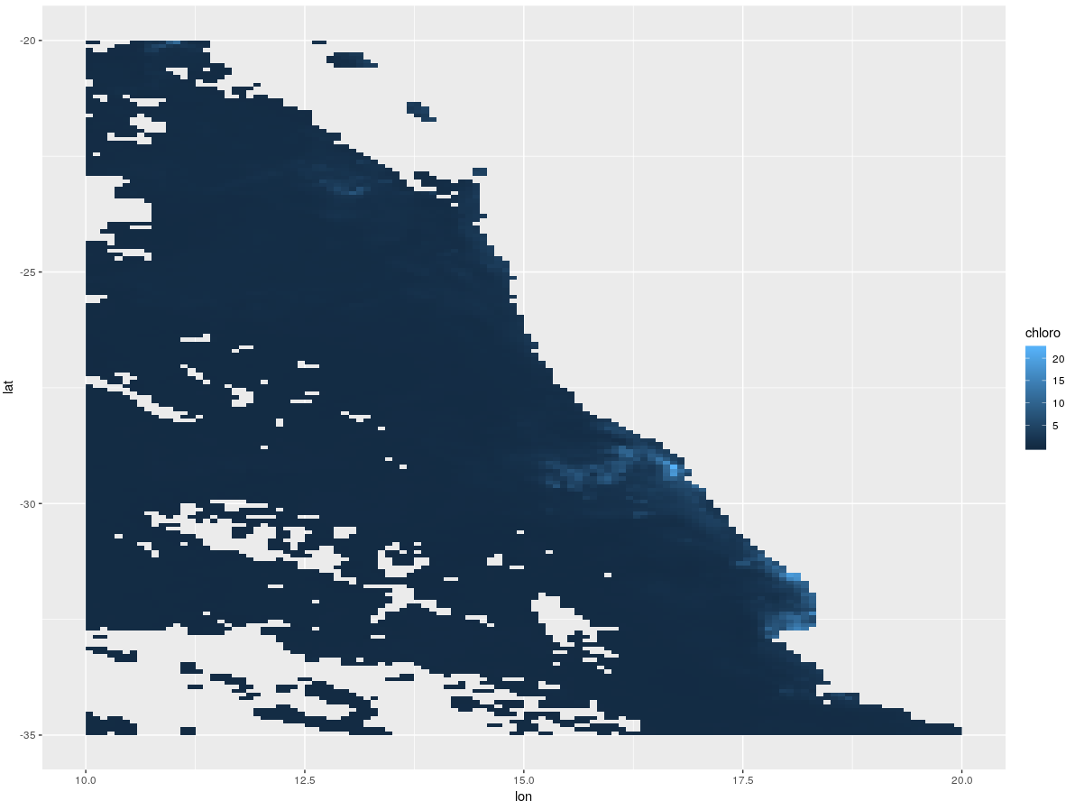
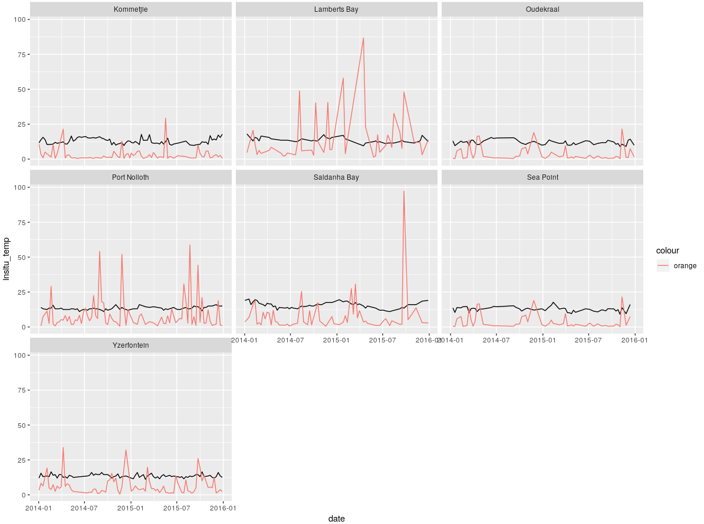
Chlorophyll-a data within upwelling regions
- Still to download 2 daily chloro dataset
Notes:
<number>

Slide 25
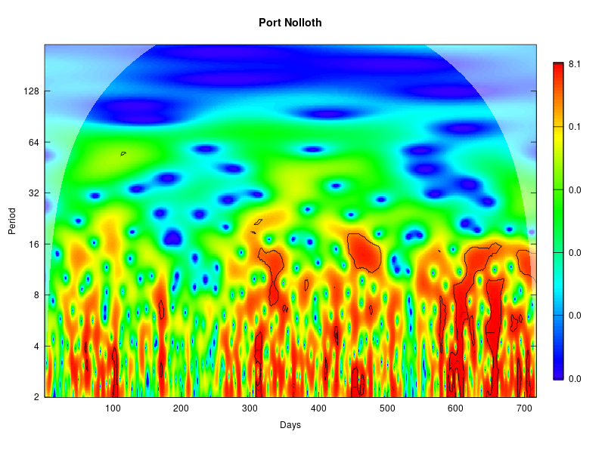
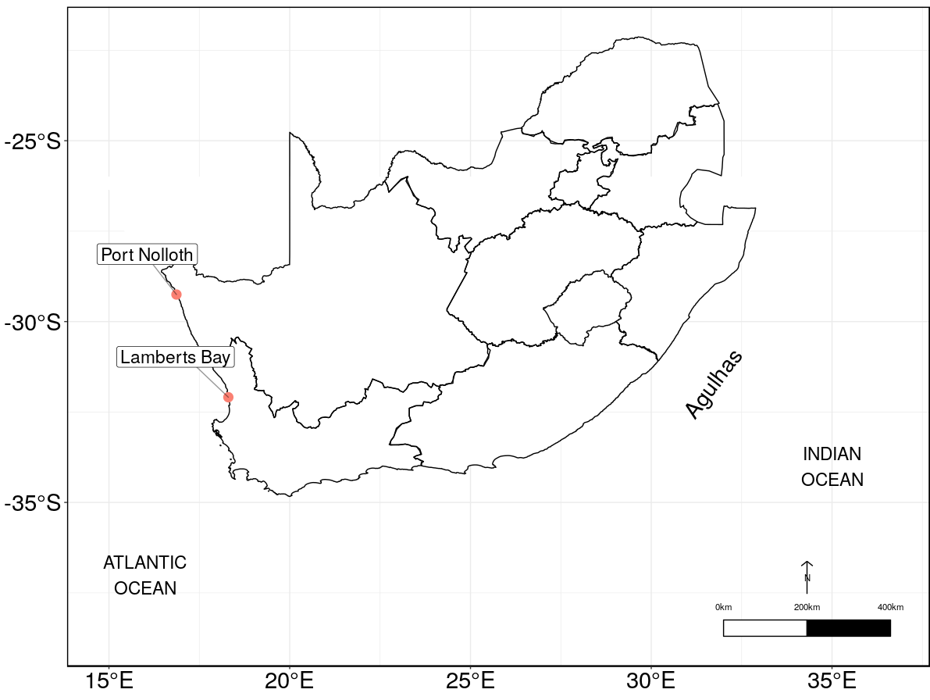
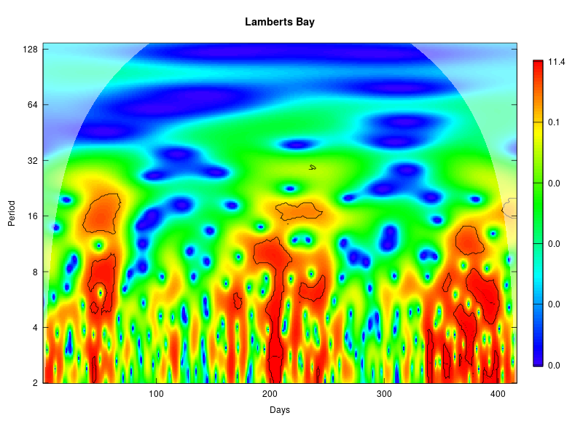
Notes:
<number>

Slide 26
Wind-rose diagrams (SAWS wind-data)
NCEP data and other wind data?
- Changed the start and end dates of the time series and sent in a request to the SAWS for new wind data for the rest of the sites
Notes:
Data was minimised by only looking at the temperature recorded after 2001 and only to extract those data or locations which had more than one source. Once this was determined a site list was constructed to identify all the sites which had more then one source and this constituted 8 of the sites
we were able to create a plot which shows the overlapping time by the sites
<number>

Slide 27
Geostrophic currents
- Created this for the Agulhas current, require BC data still. See script titled geostrophic_current.Rmd
Notes:
Data was minimised by only looking at the temperature recorded after 2001 and only to extract those data or locations which had more than one source. Once this was determined a site list was constructed to identify all the sites which had more then one source and this constituted 8 of the sites
we were able to create a plot which shows the overlapping time by the sites
<number>

